Slide 1

Images & Description
02|
EXEMPLES
Brice
Prince of Darkness
Waiting for his moment
Circa 2018

Slide 2
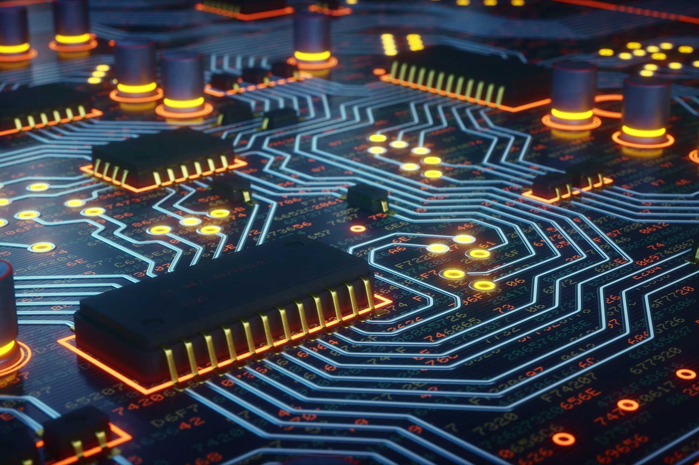
Electronic & Embedded Systems
Lecture 01
- Passive components
Brice PARILUSYAN
PhD Student
brice.parilusyan@gmail.com

Slide 3

Course overview
01|
Fundamentals
02|
Electric Circuits
03|
Basic Components
04|
Oscillators Systems

Slide 4
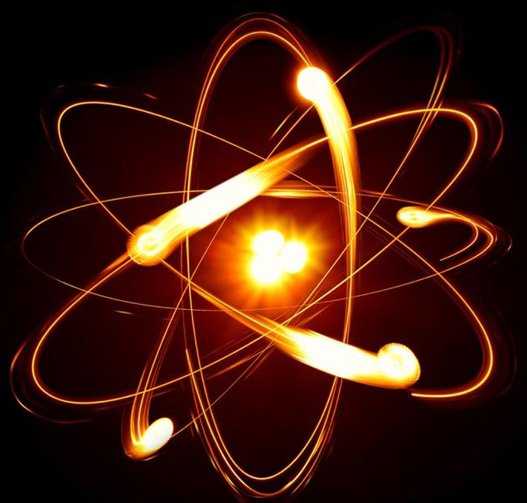
Fundamentals
Electricity Principles
Physical implications

Slide 5
1|
Fundamentals
Electricity Principles
Atoms & Molecules
Electricity & liquid
Electric current
Electric tension
Ground
Potential difference
Active circuit

Slide 6
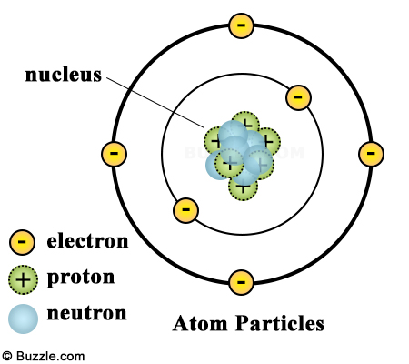
Atoms & molecules
1|
Fundamentals
Definitions :
An atom is composed of positive and negative loads. Both positive and negatives load are in equal number.
A electronic layer is a position where negatives charges are positioned around the atom. Each one has a name and contain a maximum number of electrons :
K > 2
L > 8
M, N, O …
A molecule is a pack of atoms.
Notes:
Explication atomes avec couches électronic K, L, M …
Saut des électrons entre atom = courant
Liaison de valence maintine l’atom stable
Mettre sur 2 slides avec liaisons covalence
Mettre les ions

Slide 7
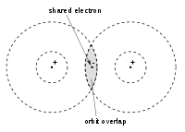
Atoms & molecules
1|
Fundamentals
Definitions :
A valence layer is the last layer with electron on it.
A covalence link is when an electron from a valence layer is shared with another atom.
The electricity is the ability of the electron to move from an atom to another. The balance in electric load is possible because of the covalence link.
Notes:
Explication atomes avec couches électronic K, L, M …
Saut des électrons entre atom = courant
Liaison de valence maintine l’atom stable
Mettre sur 2 slides avec liaisons covalence
Mettre les ions

Slide 8
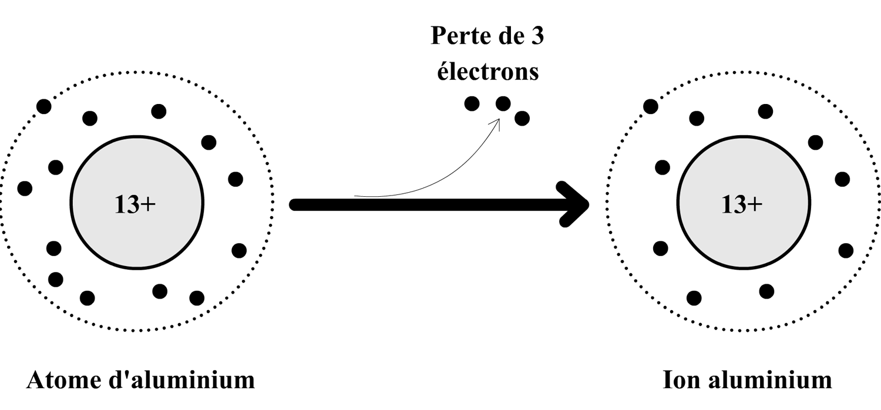
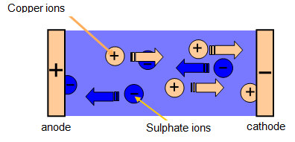
Electricity & liquid
1|
Fundamentals
Definition :
A Ion is an atom who lost his electric balance and is polarised. It occur when the atom gain or lose electrons and can not compensate with the molecule.
With this effect, electricity in liquid is made by the creation and destruction of ion. Negatively charged ion will give their excess to the anode, and those electron travel in the circuit until they reach the cathode to merge with positively charged ion.
Notes:
Explication atomes avec couches électronic K, L, M …
Saut des électrons entre atom = courant
Liaison de valence maintine l’atom stable
Mettre sur 2 slides avec liaisons covalence
Mettre les ions

Slide 9
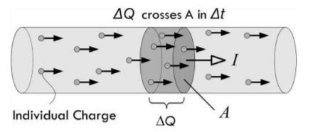
Electric current
1|
Fundamentals
Definitions :
The intensity represent the number of electron passing by a cross section of a conductive element by seconds.
Properties :
Electron = -e = 1.602 x 10^-19 C
C = Coulomb
1 A = 1 C/s
1 A = 1C / 1s = 6.24 x 10^18 electrons/s
Intensity I is measured in Ampere A
Notes:
Exos sur calcul de charge
deltaQ = I x Delta T =2A 3s = 6C

Slide 10
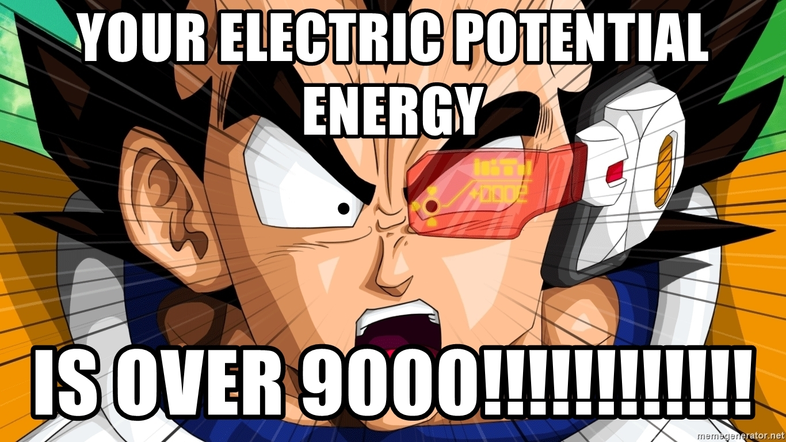
1|
Fundamentals
Electric potential
Definition :
An electric potential define the electric state of a point in space. Each element have an electric load, this value is measured in volt.
1 volt = 1 Joule / 1 C
1 joule (J) is an energy unit

Slide 11


1|
Fundamentals
Potential difference
Definition :
A potential difference represent the power who can be applied to the particles by an electric field. It is the electric tension of the system in static systems. It is sometimes call voltage.
Analogy > Brat, Water
Properties :
Voltage = U or V
Electricity flow from positive to negative
Electron flow from negative to positive
Notes:
Notion joule / énergie à noté

Slide 12
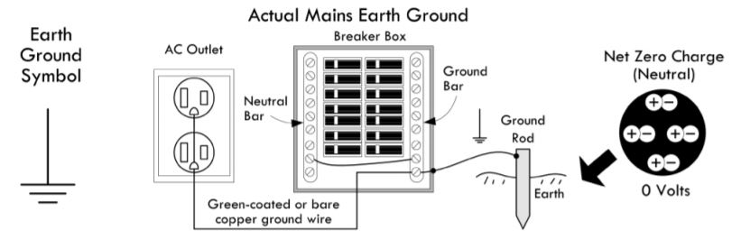
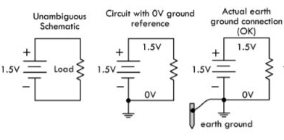
1|
Fundamentals
Ground
Definition :
The ground is the electric reference in an electric circuit.
The name ground come from the fact that real ground (in building for example), is a metallic stick stuck in the ground. It use the electric potential from the earth

Slide 13
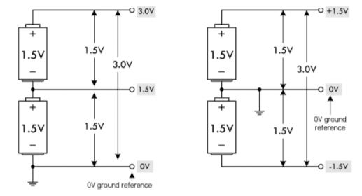
1|
Fundamentals
Ground
Properties :
The ground is the reference from which all tension are calculated
Electric tension can be added or subtracted, all is calculate from the ground and considering the electric generator polarization.

Slide 14
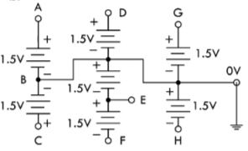
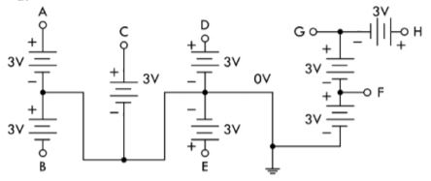
1|
Fundamentals
Ground
Exo1: find U of A to H
Exo2: find U of A to H

Slide 15
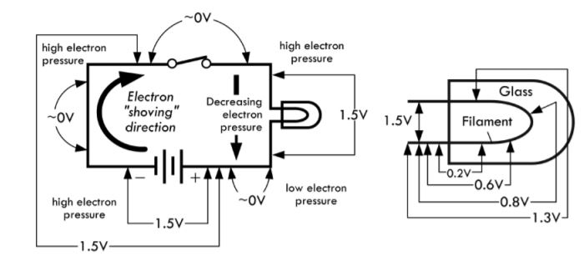
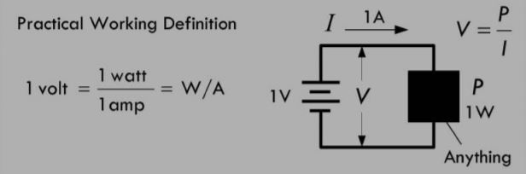
1|
Fundamentals
Active components
Definition :
An active component is an element who transform current in another element (heat, light, movement). These components cause a voltage drop.
A voltage drop is a lost in tension between the two poles of a component.
The Watt (W) is a power unit used in electricity.
W = V x A
W = U x I
Notes:
Composants actif = consomme courant

Slide 16
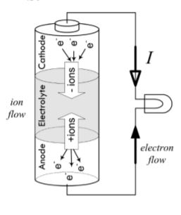
1|
Fundamentals
Battery
Definition :
A battery is a system able to store energy in a different form than electricity. Most of the time, energy is store with chemical components and free it with a chemical reaction. Once the electrons are accumulated to one side of the battery, it create a potential difference between the two side and generate current.
Battery have a limited life time. Some of them can be recharged.
Recycle batteries, it’s important

Slide 17
1|
Fundamentals
Physical implications
Signals
Electric fields
Electromagnetism

Slide 18
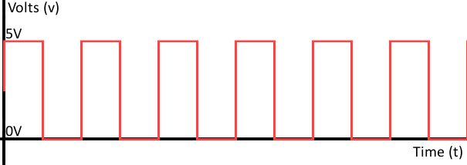
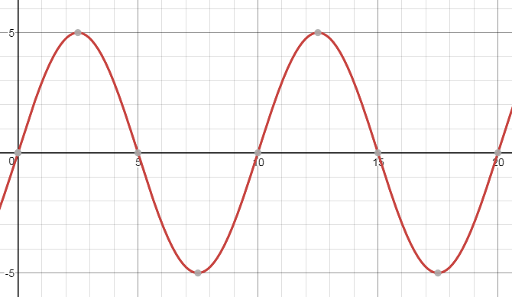
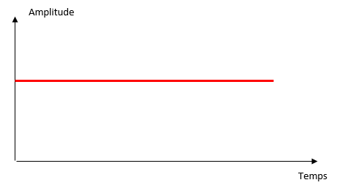
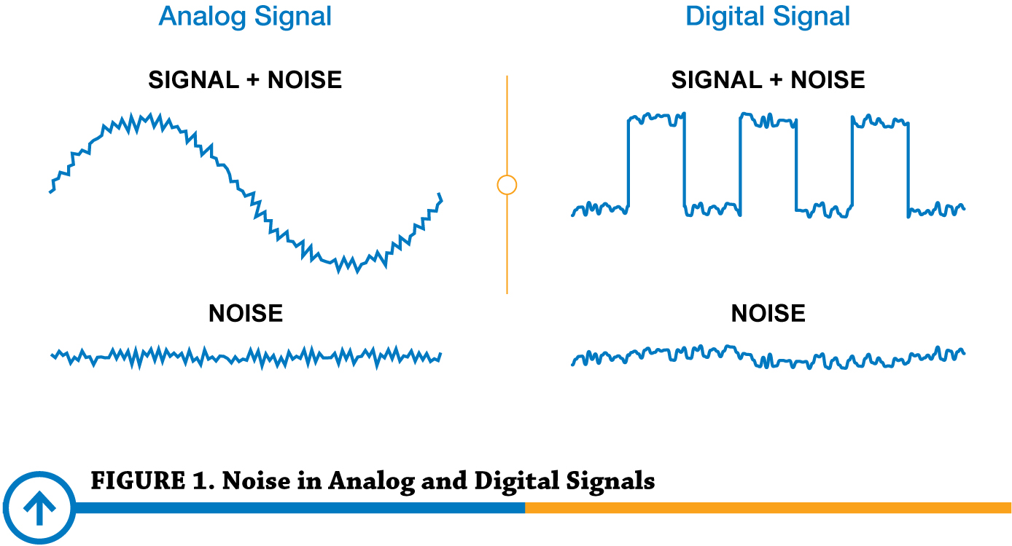
1|
Fundamentals
Signals
Definition:
A signal is an energy variation over time.
We use 3 kinds of signals :
Continuous signal
Analogic signal
Digital signal
All signals are made of :
A continue signal
An analogic signal
A parasitic noise

Slide 19
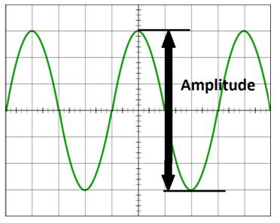
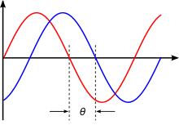
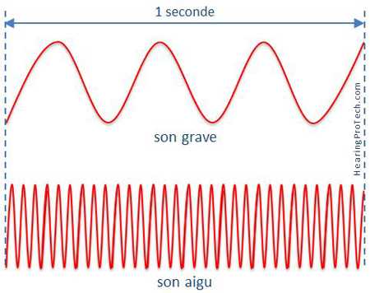
1|
Fundamentals
Signals
Definition :
A period is a pattern repetition in the signal
A signal is characterised by 3 different values :
Amplitude : maximal tension value
Phase : delay in period
Frequency : nb of periods in a second

Slide 20
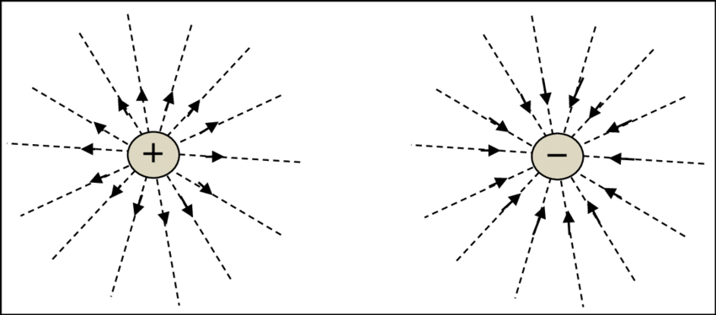
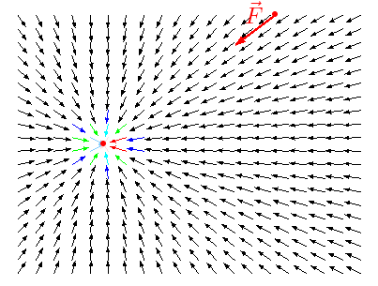
1|
Fundamentals
Electric fields
Definition :
An electric field is a vectoral field made from electrically charged opposite particles.
Properties :
The electric influence of a particle depend of the distance from it
Positive charge influence the field in the opposite of negative charge, it result a magnetic attraction

Slide 21
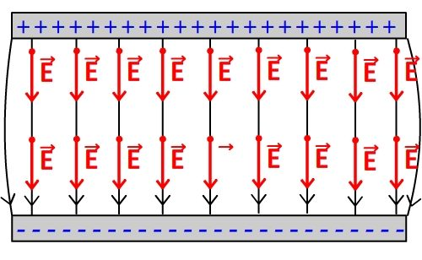
1|
Fundamentals
Electric fields
Properties :
If two plates facing each others are electrically charged in opposite, this will create an electric field.
If a charged particle penetrates an electric field, it will be influenced by it, depending of his electric load.

Slide 22
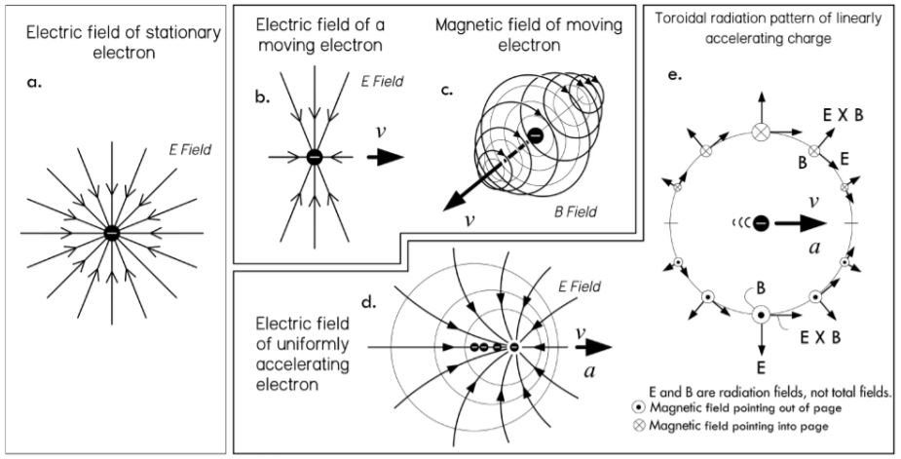
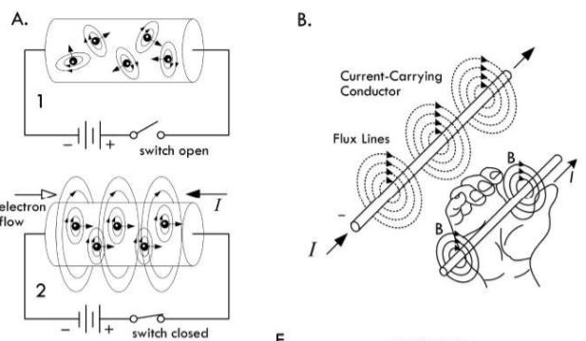
1|
Fundamentals
Electromagnetism
Definition :
Electromagnetism define a domain when we study the effect of electric fields with magnetic field.
A magnetic field is generated by the movement of an electrically charged particle. A magnetic field tend to initiate movement to other electric particles.
The right-hand rule is a method to find the direction of rotation of the magnetic field. The thumb show the direction of the movement and other finger the magnetic field wrapping it.

Slide 23
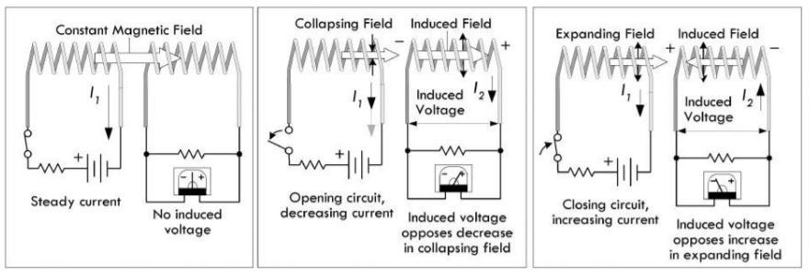
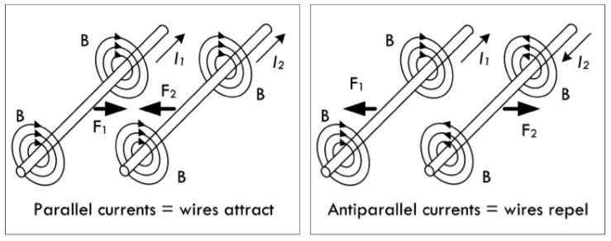
1|
Fundamentals
Electromagnetism
Definition :
Induce current represent the ability of a magnetic field to create a movement in the particles of a wire inside his range. It mean a magnetic field can generate current to a wire without physical contact.
Properties :
Two magnetic field can interact. If the current who generated them are on the same direction, the fields attract. If they are opposite, they repels

Slide 24
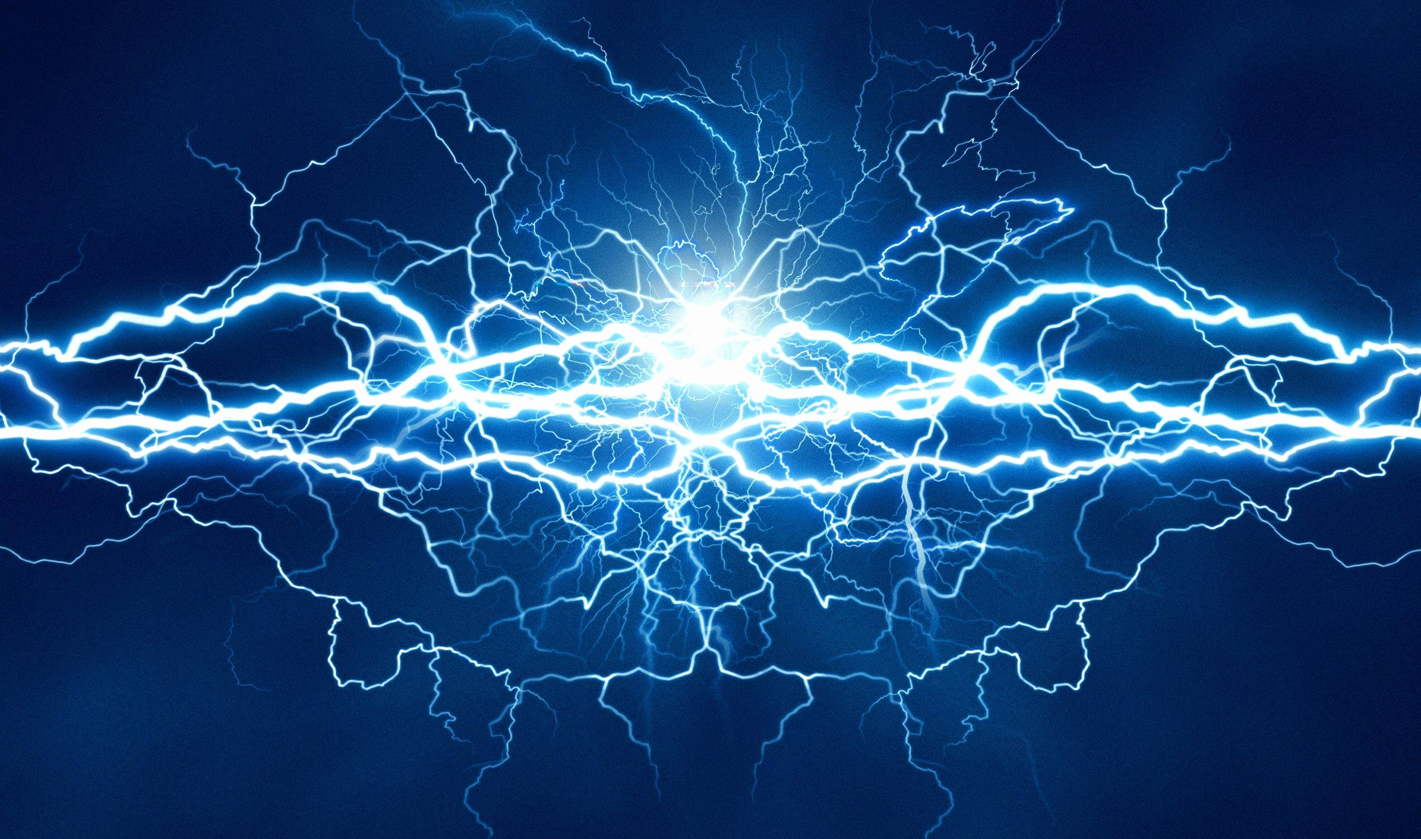
Electronic basics
Resistors
Capacitor
Inductors

Slide 25
2|
Electronic basics
Resistors
Physic explication
Ohm’s law
Kirchhoff’s law
Thermal dissipation
Basic circuits
Parallel circuits
Series circuits

Slide 26
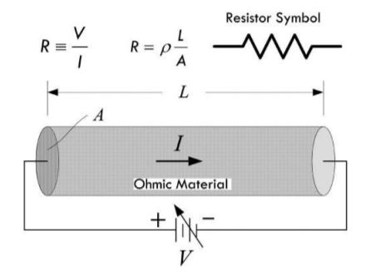
2|
Electronic basics
Physic explication
Definition:
A resistor is a component who limit the amount of current passing through it. This limitation is made from a diameter reduction or change in material composition
A resistor is noted R in electric circuit. His value is in Ohm

Slide 27
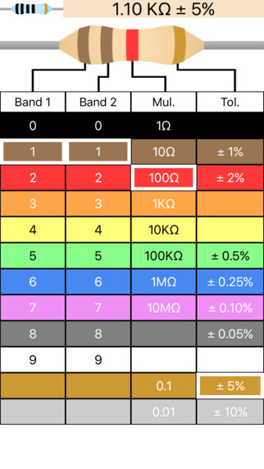
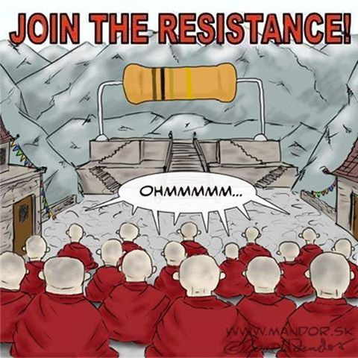
2|
Electronic basics

Slide 28
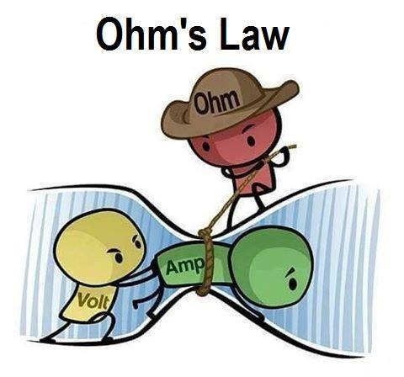
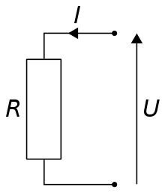
2|
Electronic basics
Ohm’s law
Definition :
The Ohm law is a linear relation between the value of a resistor, the current and the voltage.
U = R x I
U represent the entering voltage, it is not affected by the resistor value.

Slide 29
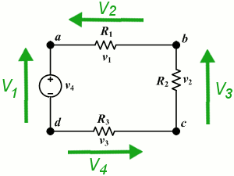
2|
Electronic basics
Kirchhoff’s law
Definition :
The Kirchhoff’s law, or node law, represent the balance will of electricity. It say that in a close loop, all current value added is equal to 0.
V1 = V2 + V3 + V4
V4 + V2 + V3 – V1 = 0
Example :
V1 = 7v
V2 = 4v
V4 = 1.5v
V3 = ?

Slide 30
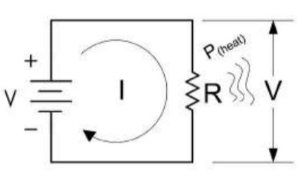
2|
Electronic basics
Thermal dissipation
Definition :
The thermal dissipation represent the heat produce by a component. This heat come from the activity of the component, using electricity. Resistors produce a lot of heat. The formula to calculate it is a derivate of Ohm’s law.
Ohm’s Law :
U = R x I
Power Loss :
P = U x I
P = I² x R
P = U² / R

Slide 31
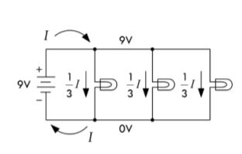
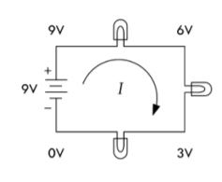
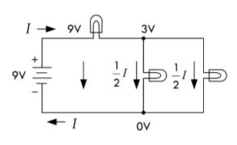
2|
Electronic basics
Parallel circuit
Basic circuit
Series circuit
Hybrid circuit

Slide 32
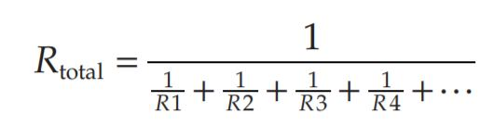
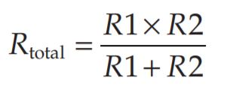
2|
Electronic basics
Parallel circuit
Properties :
Parallel resistor circuit can be simplified in one resistor. The value of this equivalent resistor is the calculated with the top formula. The bottom formula is a simplification of the top one with only two resistors

Slide 33
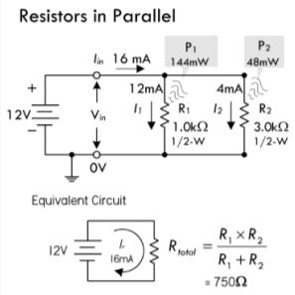
2|
Electronic basics
Parallel circuit
Example :
If a 1000- Ω resistor is connected in parallel with a 3000- Ω resistor, what is the total or equivalent resistance? Also calculate total current and individual currents, as well as the total and individual dissipated powers
Notes:
If a 1000- Ω resistor is connected in parallel with a 3000- Ω resistor, what is the total or equivalent resistance? Also calculate total current and individual currents, as well as the total and individual dissipated powers.
12V

Slide 34
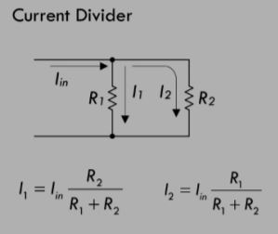
2|
Electronic basics
Parallel circuit
Properties :
A current divider is made from resistor in parallel. Indeed, in this circuit the current is divided in the different path, the current value depending of the resistors values.
Even without the U know, you can calculate the I in a current divider.

Slide 35
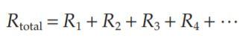
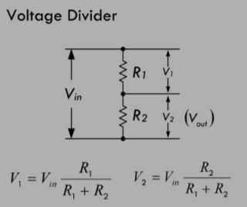
2|
Electronic basics
Series circuit
Definitions :
Resistors in series can be simplified by adding their values
A voltage divider is made from resistors in series. Depending of the resistances values, the current is divided between them.
V = Vin x (Ri / Rtotal)
Notes:
Example 1: If a 1.0- kΩ resistor is placed in series with a 2.0- kΩ resistor, the total resistance becomes: Rtot = R1 + R2 = 1000 Ω + 2000 Ω = 3000 Ω = 3 kΩ

Slide 36
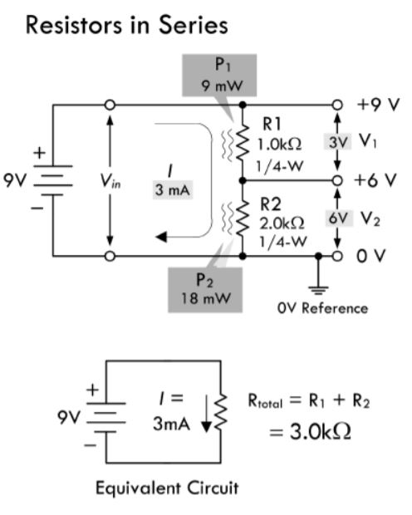
2|
Electronic basics
Series circuit
Example :
Example 1: If a 1.0- kΩ resistor is placed in series with a 2.0- kΩ resistor, the total resistance becomes:
Rtot = R1 + R2 = 1000 Ω + 2000 Ω = 3000 Ω = 3 kΩ

Slide 37
More !
2|
Electronic basics
A lot of formula exist to simplify a circuit. I encourage you to find out more about it.
Superposition
Thevenin
Norton

Slide 38
2|
Electronic basics
Capacitors
Physic explication
Capacitor types
Parallel circuit
Series circuit
Bypass capacitor
RC circuit

Slide 39
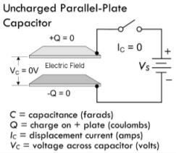
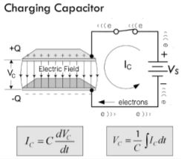


2|
Electronic basics
Physic explication
Definition :
A capacitor is composed of different layers of conductive plate facing each others. It generate an electric field between the plate when a tension is applied.
Leakage current is a phenomena who happen when a capacitor is disconnected of the power source, it mean the capacitor lose his energy over time.
Capacitor values are in Farad (F)
1F = 1C/1V

Slide 40

2|
Electronic basics
Capacitor types
Properties :
Different kind of capacitors exist. Fixed capacitors are usually made from ceramic.
Polarized capacitors have a plug way. They must be plugged in the right way, otherwise there is a risk of explosion.

Slide 41

2|
Electronic basics
Parallel circuit
Definition :
Capacitors in parallel see their values adding, like for resistors in series.
Parallel capacitors limit max voltage rating to that of the smallest capacitor.

Slide 42

2|
Electronic basics
Series circuit
Definition :
Capacitors in series increase the max voltage, but decrease the capacitance value.
The capacitance value is lower than the smallest capacitor of the series

Slide 43


2|
Electronic basics
Series/parallel circuit
Example :
Find the total capacitance and maximum working voltage (WV) for the capacitor in the parallel network.
(b) Find the total capacitance, WV, V1, and V2.

Slide 44

2|
Electronic basics
Bypass capacitor
Definition :
A bypass capacitor is a capacitor connected between the ground and the VCC. This circuit help to reduce potential noise coming from the alimentation or the circuit itself.

Slide 45

2|
Electronic basics
RC circuit
Definition :
RC circuits are used as oscillator. The charge/discharge time can be controlled with the values of resistor and capacitor. This circuit consist of a resistor and capacitor in series. During the charge and discharge of the capacitor, the voltage value between the two component evolve
During charge, the voltage rise between the component.
Notes:
An IC uses an external RC charging network to control its timing. The IC requires 3.4 V at VIN to trigger its output to switch from high to low, at which time an internal transistor (switch) is activated, allowing the capacitor to be discharged to ground. If a 5- s timing period before the trigger point is required, what value of R is required if C = 10 µF?

Slide 46



2|
Electronic basics

Slide 47

2|
Electronic basics
RC circuit
Definition :
RC circuits are used as oscillator. The charge/discharge time can be controlled with the values of resistor and capacitor. This circuit consist of a resistor and capacitor in series. During the charge and discharge of the capacitor, the voltage value between the two component evolve
During discharge, the voltage drop between the components
We consider a capacitor discharged after a time = 5𝜏

Slide 48


2|
Electronic basics

Slide 49
2|
Electronic basics
Inductors
Physic explication
Inductor fabrication
Series / parallel circuit
Inductive divider
RL circuit

Slide 50


2|
Electronic basics
Physic explication
Definition :
An inductor is a conductive wire twisted on itself in a reel. With this shape, every twist create a magnetic field, all this field add, and it create a bigger magnetic field at the scale of the inductor.
Different kind of inductors exist, some are twisted around magnetic or iron core to increase the magnetic field power.

Slide 51

2|
Electronic basics
Physic explication
Properties :
When current is applied to an inductor, it will start to load an electromagnetic field (EMF). During loading, the field will slow electrons in the wire and create a signal phase shift.
When the EMF is loaded, it work as a wire.
When the current source is removed, the EMF collapse. The discharge of the EMF create a temporary power source.
The basic unit of inductor is the henry (H)
1H = 1V / 1A/s

Slide 52

2|
Electronic basics
Inductor fabrication

Slide 53



2|
Electronic basics
Series/parallel circuit

Slide 54

2|
Electronic basics
Inductive divider
Definition :
Inductive dividers can be used with ac input signals. A dc input voltage would split according to the relative resistances of the two inductors by using the resistive voltage divider

Slide 55


2|
Electronic basics
RL circuit
Definition :
An RL circuit is a resistor in series with an inductor, the resistance controls the rate at which energy is pumped into the magnetic field of the inductor (or pumped back into the circuit when the field collapses).
Basically, an RL circuit control the time that a circuit take to reach its maximum current value

Slide 56

2|
Electronic basics
RL circuit

Slide 57



2|
Electronic basics
RL circuit
Caution :
In A, a break in current flow caused by opening a switch will cause a large inductive load’s magnetic field to collapse, thus generating a large forward voltage. Electron pressure between the switch contacts becomes so large that electrons escape the metal surface of one switch contact and jump toward the other contact. Trough physics effects, it lead to a spark discharge across the switch contacts.

Slide 58

2|
Electronic basics
RL circuit

Slide 59

Basic Components

Slide 60
Transformers
3|
Basic Components

Slide 61


3|
Basic Components
Definition :
A transformers is two inductors twisted around a magnetic core. One of the inductor will induce current inside the other.
The induce current depend of the twist number of the inductors.
Both inductors are electrically isolated, they have air between them, it’s called a galvanic isolation.
Ns = nb twist secondary
Np = nb twist primary
Vs = voltage secondary
Vp = voltage primary

Slide 62

3|
Basic Components

Slide 63
Switch
3|
Basic Components

Slide 64



3|
Basic Components
Definition :
A switch is a mechanical device that interrupts or diverts electric current flow within a circuit.
Many different switch exist, all of them are simple mechanical contact between pins.
Switch, especially push buttons, are subject to the Gibbs effect. It is a noise created during the activation.

Slide 65

3|
Basic Components
Definition :
Gibbs effect is a signal disruption happening during state switching. In electronic, a switch have a Gibbs effect at each switch. It came from the fact that electron “jump” from one plate to another during the closing.
This effect is a problem for two reasons. First, it add noise to your signal. Second, the voltage drop can be dangerous for you components.

Slide 66
Relay
3|
Basic Components

Slide 67


3|
Basic Components
Definition :
Relays are electrically actuated switches. The three basic kinds of relays include mechanical relays, reed relays, and solid- state relays. For mechanical relay, a current sent through a coil magnet acts to pull a flexible spring who move from one switch contact to another. Reed relays consist of a pair of reeds (thin, flexible metal strips) that spring together whenever a current is sent through an encapsulating wire coil. A solid-state relay is a device that can be made to switch states by applying external voltages across n- type and p- type semiconductive junctions
Before a relay, its is advised to put a component to avoid current spike

Slide 68

Oscillators Systems

Slide 69
Oscillators Systems
RLC circuit
RLC applications

Slide 70
4|
Oscillators Systems
RLC circuit
Reactance
Impedance
RLC resonance frequency
RLC phase diagram
RLC parallel
Oscillator circuit

Slide 71


4|
Oscillators Systems
Definition
Definition :
Reactance is an imaginary equivalent of resistance for capacitor and inductor. The reactance is noted X, and considering his value, the circuit has different resistance type :
X > 0 = inductive
X = 0 = resistive
X < 0 = capacitive

Slide 72


4|
Oscillators Systems
Impedance
Definition :
The impedance is the measure of the opposition of a circuit to a sinusoidal signal. It is a generalization of the Ohm law for sinusoidal signals.
The admittance Y is the inverse of the impedance Z
Z = R + jX = root(R² +(XL – XC)
Y = 1/Z
Z = impedance in Ohm
R = resistance in Ohm
X = reactance
Y = admittance

Slide 73


4|
Oscillators Systems
RLC resonance frequency
Definition :
Resonance frequency in RLC is the frequency when the inductance and capacitance annulate each others. At this moment, the circuit become only resistive

Slide 74


4|
Oscillators Systems
RLC phase diagram
Definition :
The Fresnel representation or Fresnel diagram is a graphical tool for adding, subtracting, deriving and integrating sinusoidal functions of the same frequency.

Slide 75

4|
Oscillators Systems
RLC phase diagram
Exercise :
1) Find Xc, XL, Xr.
2) Calculate Z
3) Calculate the resonance frequency.
4) Draw the phase diagram

Slide 76

4|
Oscillators Systems
RLC Parallel
Definition :
Parallel RLC, are more common than series RLC. The formula must be adapted to the structure (Z became a bridge divider).
Practical electronic for inventor. P.196

Slide 77


4|
Oscillators Systems
RLC oscillator
Definition :
Oscillator systems is a use of RLC circuit. It can generate a continuous signal with specific frequency. Moreover, this signal is modifiable by changing capacitor/inductor value. It works as an LC, but with specific resistors (negative resistors circuit), the RLC maintain is oscillation.

